Slide 1
Ag & Energy: Conservation through Farming Practices
Lesson 3

Slide 2
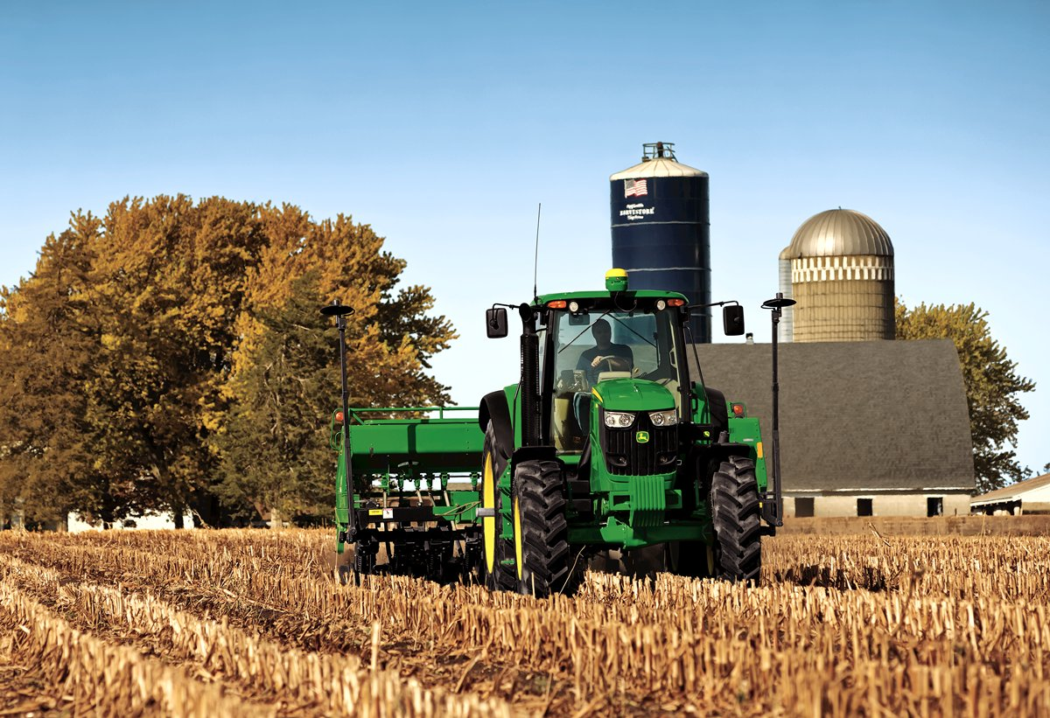
Tillage and Energy Conservation
Leaving stubble from the last harvest (no-till) offers protection from drought and erosion
Fuel costs are a major incentive to practice no-till or minimum till farming

Slide 3
Equipment sizing
Match your machinery to the power requirements of the job.
Don’t use a big tractor to pull smaller loads
Plan for multi-function operations.
Proper ballasting is important to transfer as much engine power as possible to the drawbar.
Too little weight results in excessive slippage and waste of fuel.
Too much weight lowers wheel slip but results in greater rolling resistance and fuel consumption.
Proper tire inflation also affects fuel consumption.
Correct tire inflation pressure for the load carried can be found from load and inflation tables.

Slide 4
Energy Estimator
http://ecat.sc.egov.usda.gov/
300 acres corn, 200 acres soybeans
Diesel - $2.30 per gallon

Slide 5
Drying Grain
Grain Dryer (propane)
Keep grain free of dirt and chaff.
Inspect drying floor regularly to assure free airflow
Avoid over-drying by checking moisture content frequently
Motor grain augers (electrical)
Fit your motor size to the size of your job.
Inspect motors regularly. Clean them as needed.
Get energy-efficient motors when purchasing new motors.

Slide 6
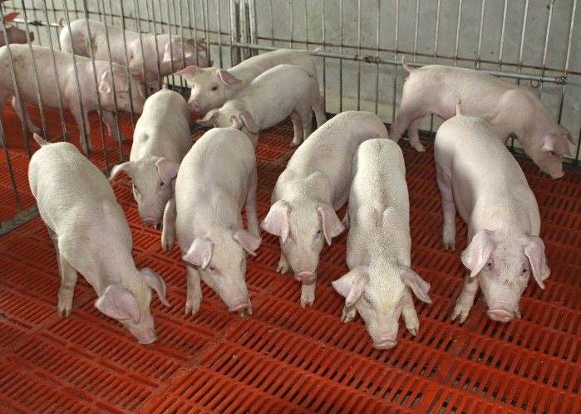
Raising Livestock - Swine
Heat Lamps
Change to lower wattage heat lamps during summer months.
Avoid long drop cords and poor connections.
Check and adjust lamp heights for maximum efficiency and safety.
Ventilation: When heating and venting, monitor thermostats & keep controls clean.
Heat Pad: Keep mats as clean as possible.

Slide 7
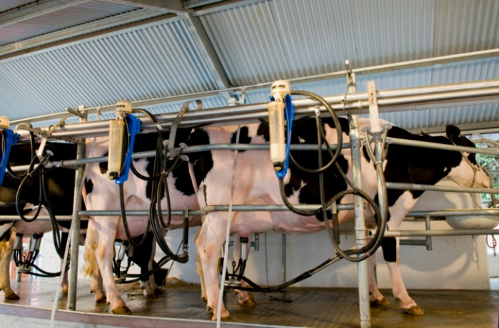
Raising Livestock - Dairy
Dairy Water Heater: Efficient water heaters can save up to 4900 kWh on a 30-cow farm.
Feed Mill: Add rodent guards to open motors and keep motors clean for efficient use and longer life.
Milk Cooler: Efficient milk coolers can save up to 23,500 kWh on a 400-cow farm. Use reclaimed heat from bulk coolers for heating water.
Milking Machine: Efficient vacuum pumps can save up to 1700 kWh on a 30-cow farm.
Silo Unloader: Avoid overloading and follow manufacturer's instructions.

Slide 8
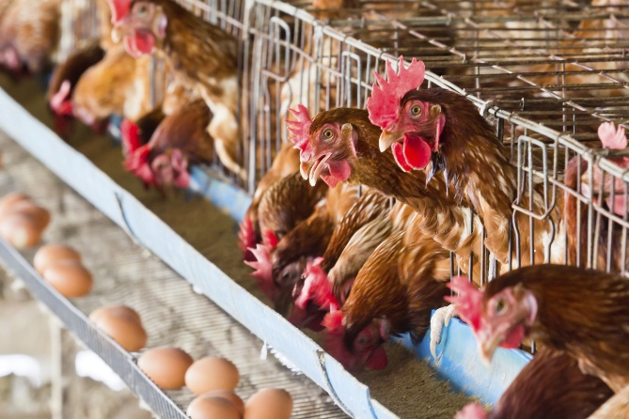
Raising Livestock - Poultry
Cleaning/Collecting
Stagger operate or rotate use of multi-motor operations.
Small horsepower conveyors are more efficient than large ones operating for short periods.
Lighting
Regularly turn off lights when they are not needed.
Light only work areas rather than entire buildings.
Keep lamps, tubes, reflectors, and lenses clean.
Consider fluorescent lighting instead of incandescent lighting.
Install mercury vapor or sodium vapor lamps for large exterior or high-bay interior areas.
Processing
Be sure that controls allow proper cycling of the cool storage system.
In egg-packing areas, dehumidification can be accomplished with a heat pump or by adding a heat recovery system to the AC. The reclaimed heat can be used for the water heating system.
Ventilation
When rooms or buildings need both heat and ventilation, check thermostats frequently to assure efficient operation.
Keep the controls clean.

